Slide 1
WCNR Orientation
Admin Pro (Non-Exempt)

Slide 2
Employee Handbook
This presentation will talk about important information that can be found in the employee handbook: https://sites.warnercnr.colostate.edu/businessoffice.
You can also find more information in the Academic Faculty and Administrative Professional Manual at: http://www.facultycouncil.colostate.edu/files/manual/table.html.

Slide 3
Electronic Identification (eID)
Your eID will give you access to important items. It will also provide an email alias that everyone at CSU will use to contact you.
Use the CSU ID number provided in the email that this was attached to set up your eID.
1. Go to https://eid.colostate.edu/.
2. Click on ‘Register for your eID’ and enter the CSU ID # provided to you in the email with this attachment.
You can forward your CSU email to another email that you check more regularly by following the instructions here: http://help.mail.colostate.edu/tt_rule_forward_email.aspx.
You will have to renew your password yearly.

Slide 4
Benefits
The Benefits Department will contact you via your CSU email address within 10 business days of WCNR HR receiving your completed original paperwork. You have 30 calendar days from your first day of work to register for benefits.
If you do not receive an email within your first week, please email WCNR_HR@mail.colostate.edu.
If you have any questions about your benefits please contact hr_service_center@mail.colostate.edu

Slide 5
Time Reporting
Your position is eligible for overtime so you must report time on an online time keeping system, TimeClock Plus.
Employees working off-campus will need to download DUO. Instructions: https://www.acns.colostate.edu/duo/. Then go to https://secure.colostate.edu and click on the TimeClock Plus hyperlink.
On campus employees access this system at https://aar.is.colostate.edu/ under the TimeClock Plus heading on the right of the page.
All shifts must be entered by the 5th of the following month to avoid a possible delay in your pay. Supervisors have until the 10th of the month to approve time sheets.
Admin Pro employees can enter their time in hours for each day worked vs. clocking in and out. Please talk to your supervisor about how your time needs to be recorded.
Overtime occurs after 40 hours per week if you are not on an alternate work schedule. Before you go overtime please make sure you have approval from your supervisor.
Comp time and Overtime = Time and a half

Slide 6
TimeClock Plus Training Video: How to enter time already worked
For more training for to: http://hrs.colostate.edu/timeclockplus/employee_training.html

Slide 7
TimeClock Plus Training Video: How to clock in and out
For more training for to: http://hrs.colostate.edu/timeclockplus/employee_training.html

Slide 8
Leave Accruals
You will need to enter your leave in Time Clock Plus
Enter time worked and leave in Time Clock Plus: https://aar.is.colostate.edu/
Leave accruals (based on full time status)
1.5 days(10 hours) earned for Sick Leave each month
(120 hours will be added to your account on your first day for your first year working)
2 days (16 hours) for Annual Leave if you are on a Special Appointment (Temporary appointments do not earn Annual Leave)
10 Holidays per year (do not enter holidays into TCP, HR will manually post them for you)
Postdoctoral Fellow appointments receive 15 days of sick leave per year; No annual leave for this appointment type. Leave is submitted monthly via the WCNR intranet. Please be sure to work with WCNR-HR to ensure leave is reported correctly.
Please submit your leave in a timely manner. Your leave will need to be entered by the 5th of the following month. (Supervisors have until the 10th to approve).
You will not be able to use the leave earned until the next month (Ex. Leave gained in August can not be used until September.)

Slide 9
TimeClock Plus Training Video: How to enter a leave request
For more training for to: http://hrs.colostate.edu/timeclockplus/employee_training.html

Slide 10
Special Leave
Contact your supervisor if you need special leave for Jury Duty.
Please notify WCNR HR if you need special leave such as parental leave/FMLA as soon as possible and we will give you guidance on how to proceed.

Slide 11
Work Schedule
Contact your supervisor about what kind of work schedule is required for your position.

Slide 12
Preventing Sexual Harassment
CSU strives to create and maintain a work environment that is fair, humane, and responsible so that each member is treated with dignity and rewarded for such relevant considerations as ability and performance.
In order to educate all employees about this important subject, Preventing Sexual Harassment training is mandatory for all employees.
The company Work Place Answers will contact you by email to complete the training. Please let us know if you do not receive within your first week.

Slide 13
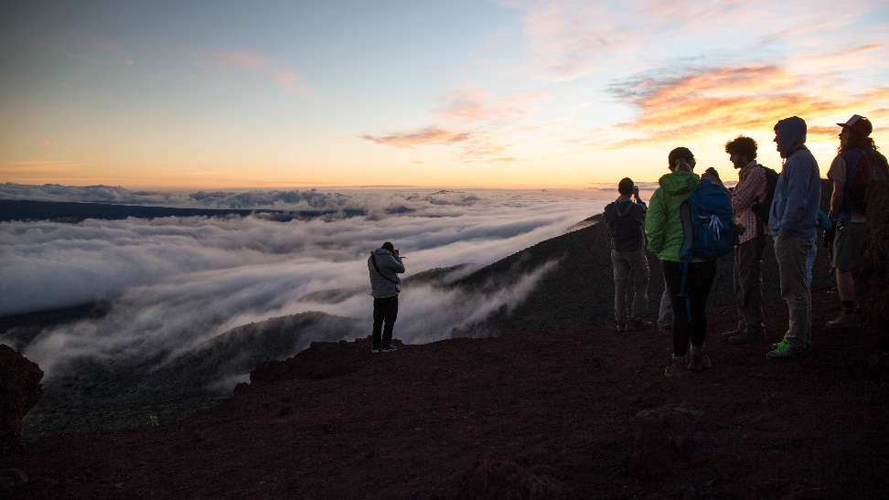
Contact Information
Once you know what your work telephone number and office number will be, please send it to us at WCNR_HR@mail.colostate.edu so we can update the directory.
If your email address changes, you will need to update it in the eID system so that we are able to stay in contact with you.

Slide 14
Conflicts of Interest (COI)
Addressing potential or perceived conflicts of interest is important to protect yourself and CSU.
Be mindful that you are a CSU employee and cannot represent the military or sponsor in any way.
Upon hire and yearly thereafter, a Conflict of Interest survey is required.
On-campus employees:
1. Go to http://COI.colostate.edu.
2. Click ‘Colorado State University’ and sign in using your eID.
Off-campus employees:
1. Go to https://secure.colostate.edu and sign in using your eID and DUO.
2. Click Conflict of Interest (COI) link.
Once logged in...
1. Click ‘COI’ on the top left then ‘Create my Annual Disclosure’ in the drop down box.
2. Click ‘expand all’ on the top right.
3. Answer the questions.
4. Click the box at the bottom under certification then click ‘Submit’.

Slide 15
Extra Information
You will be paid the last working day of each month. If the last day of the month falls on a Saturday you’ll receive your pay on the previous Friday.
If you are injured at work please submit an incident report as soon as possible. http://rmi.prep.colostate.edu/workers-compensation/file-an-incident/

Slide 16
Thank you! Welcome to WCNR!
If you have questions about benefits contact hr_service_center@mail.colostate.edu.
If you have any other questions or concerns please email wcnr_hr@mail.colostate.edu

